Slide 1

[ Survey Results Of Tablet Launch]

Slide 2
Summary
The project team was given an objective of increasing customer satisfaction by rolling out a tabletop menu tablet. To achieve this the following was done:
Designated two pilot sites
Procurement and installation of tablets
Working closely with the marketing team and the head chef Carter to develop a new and interactive menu
Development and training of staff on the tablets

Slide 3
Overview
With the pilot our objective was to produce the following:
●Streamline the ticket time from request to table. 8 minutes for appetizers and 12-15 minutes for entrees.
●Reduce the checkout time and improve the payment process
●Minimal technical issues with the tablets
●Maintain a 98% order accuracy
●Decrease the average wait time to under 10 minutes to be seated

Slide 4
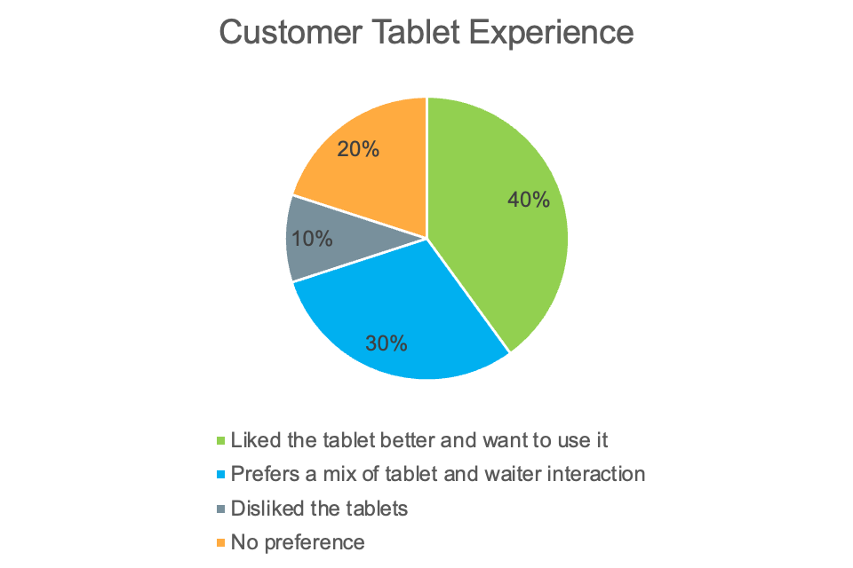
Findings
When asked if the customer preferred the tablet experience compared to the traditional experience with a waiter

Slide 5
Next Steps
56% of customers received their food order in less than 20 minutes and 54% waited 15+ minutes for a table
Work with staff and Chef to determine ways to streamline in the kitchen
Make sure the customers seated understand the tablets so they can order in a more efficient manor

Slide 6
Next Steps
78% of customers signed up for the newsletter, while only 16% signed up for the Birthday Club
●Reach out to marketing and provide feedback
●Possible update to the menu design promoting the club more
●Encourage involvement by offering a coupon for sign up

